Slide 1

Rozzi Travel – your reliable partner in Bulgaria.
NOTE:
To change images on this slide, select a picture and delete it. Then click the Insert Picture icon
in the placeholder to insert your own image.

Slide 2

We offer
professionally escorted itineraries, appealing to both - first time and
repetitive visitors that explores all diversitıes of Bulgaria.
We provide not only
- Guided tours all around Bulgaria.
- Ski holidays and summer vacations.
- Best deals on accommodation all around the country.
- Transfers & transportation all over Bulgaria.
BUT customize packages to fit your needs individually.
We offer also:
.

Slide 3
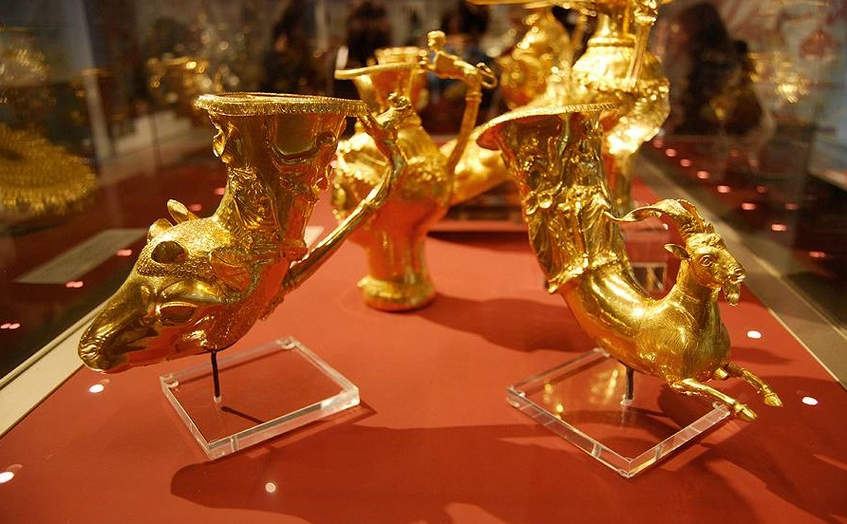
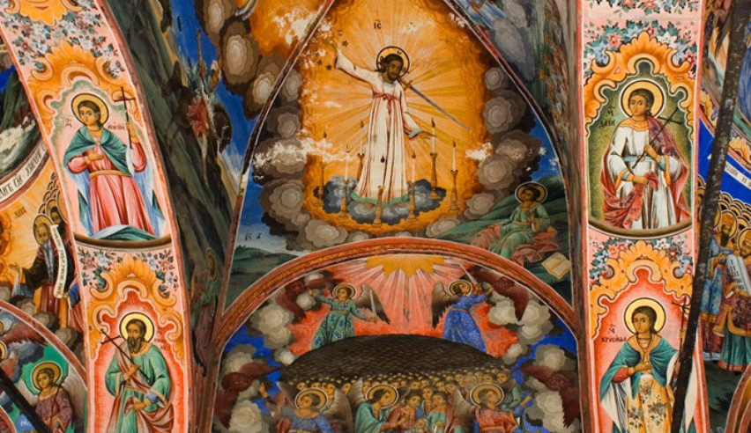
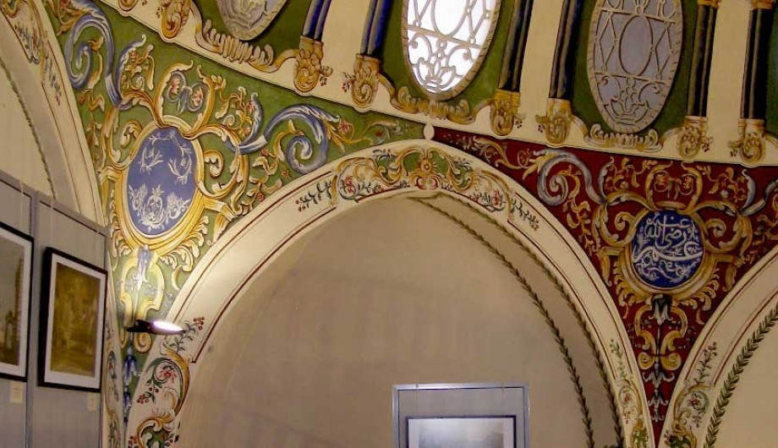
Bulgaria is a country of 7 civilizations and we shall guide you through its treasures.

Slide 4
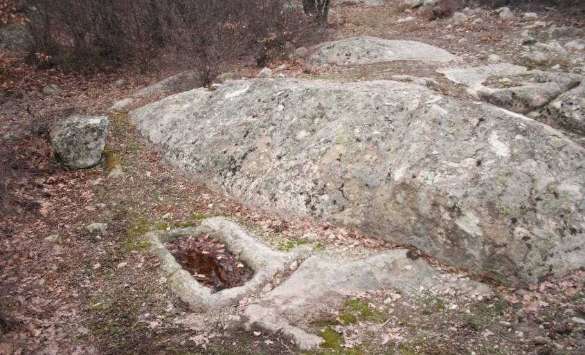
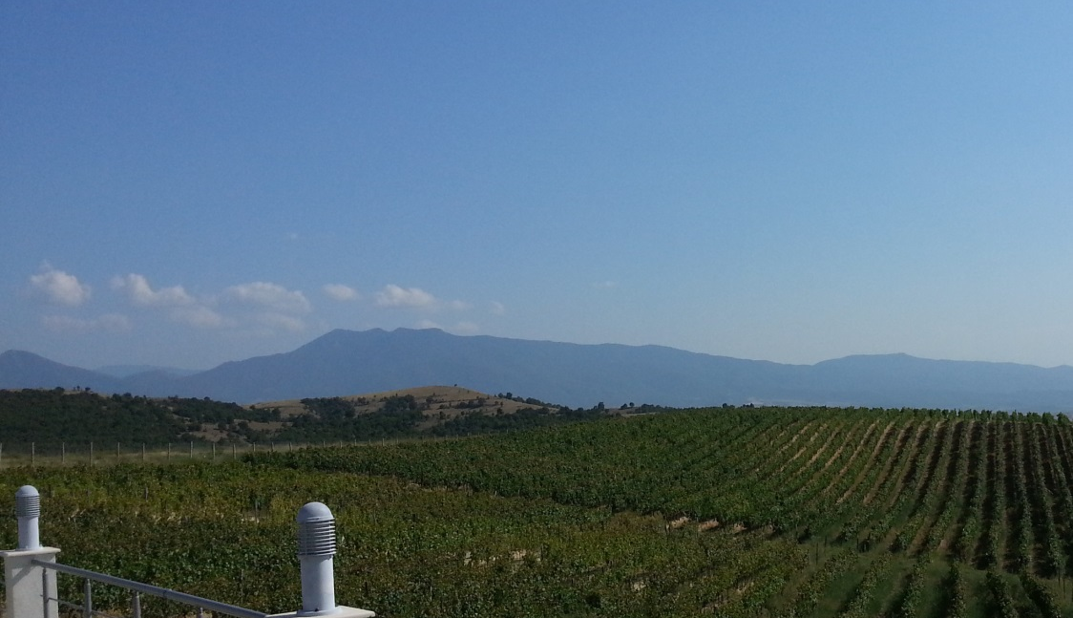
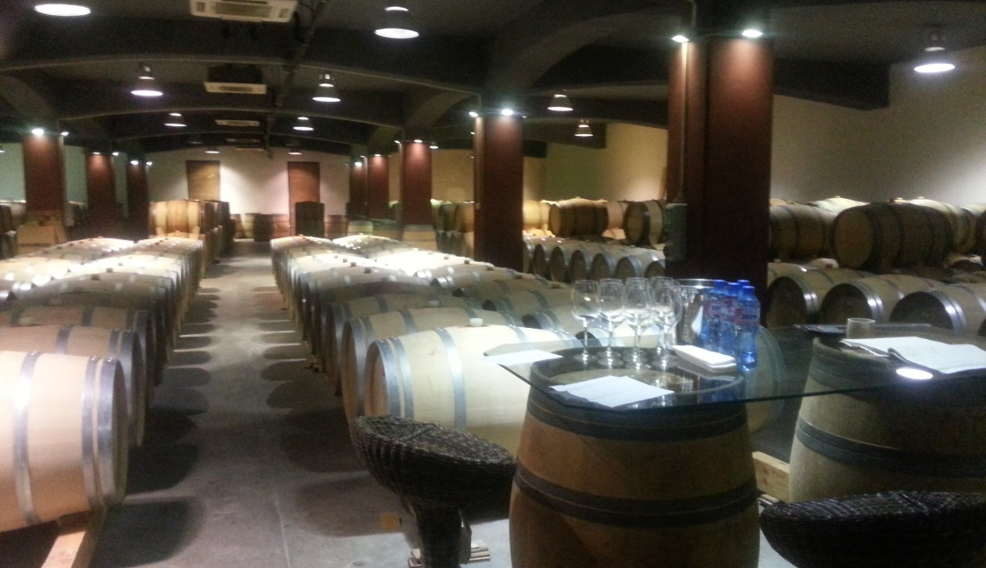
From the age of Ancient Thrace we have inherited not only cultural monuments, tombs and temples, but as well the art of wine making.

Slide 5
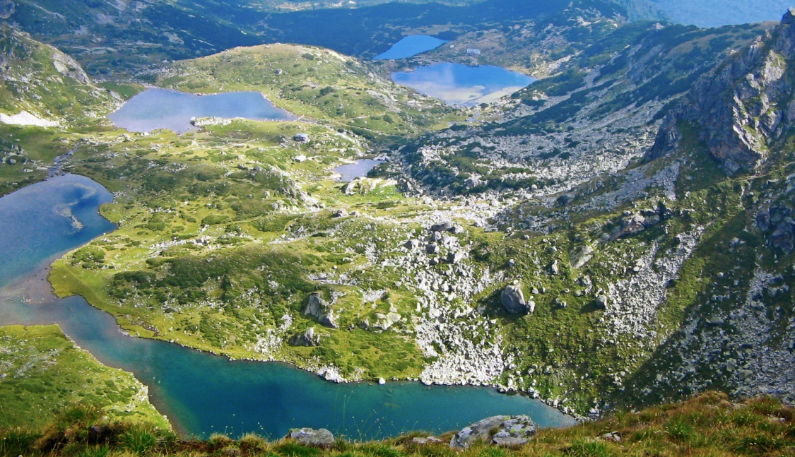
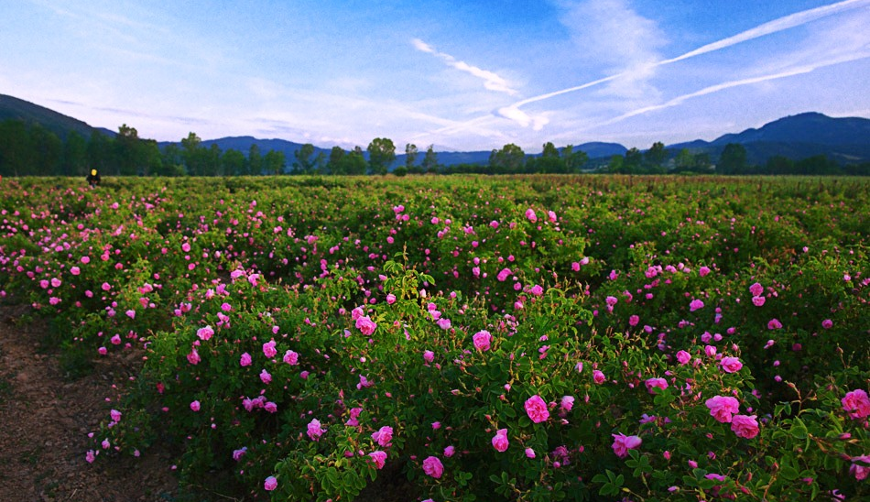
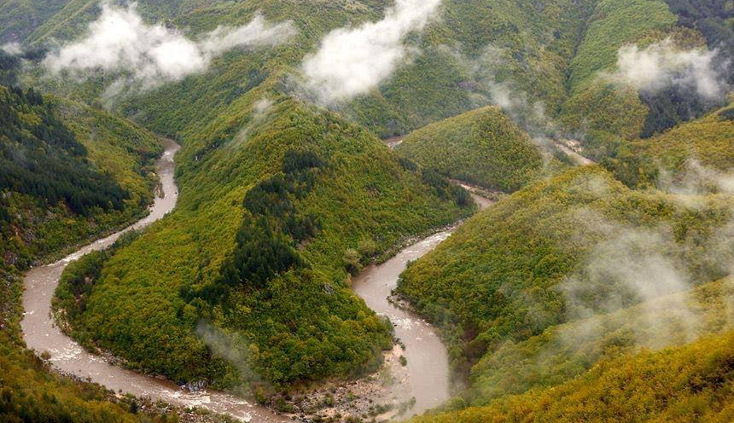
We are proud with our nature and Rose Valley and will be happy to show them to you and your clients.

Slide 6
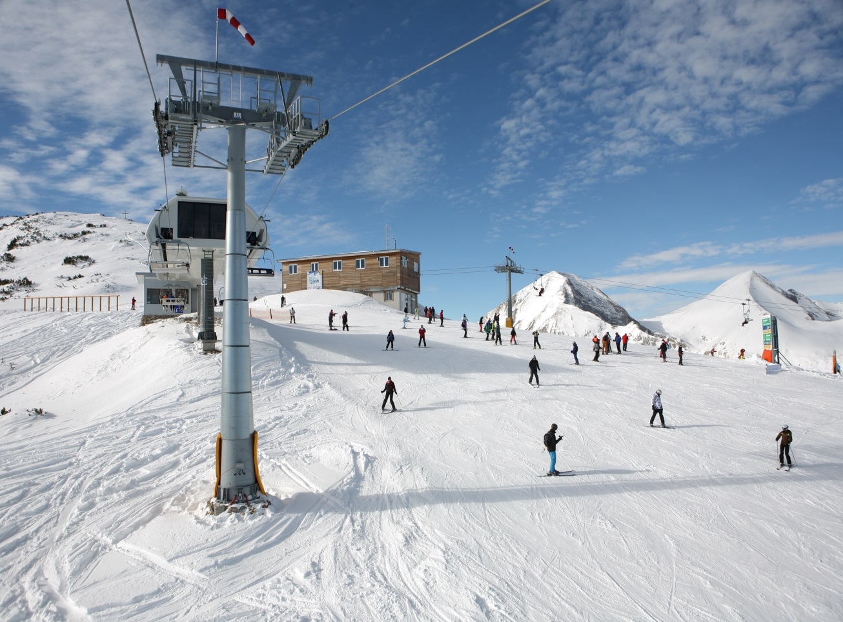
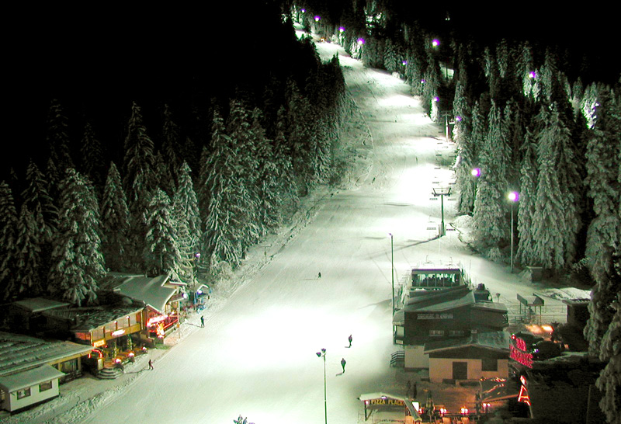
Rozzi Travel will help you to discover Bulgarian mountain resorts.

Slide 7
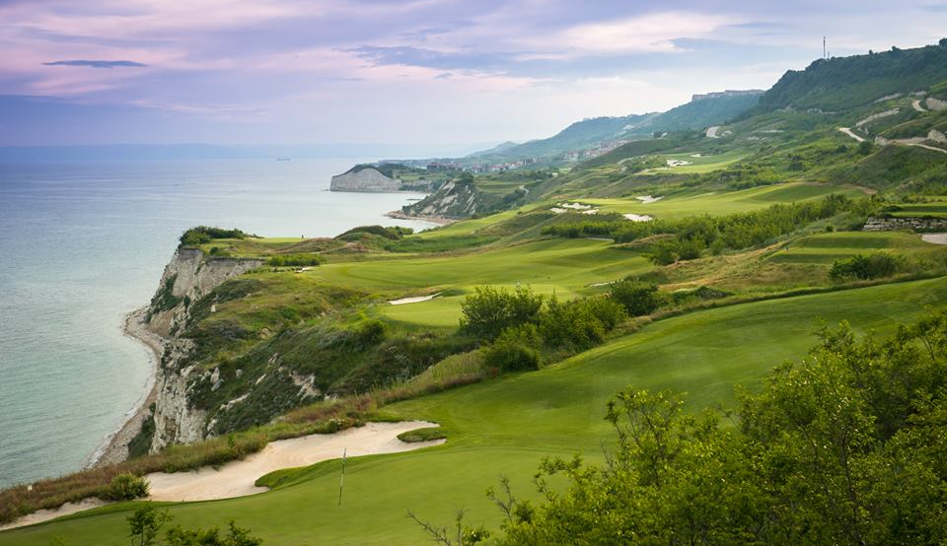
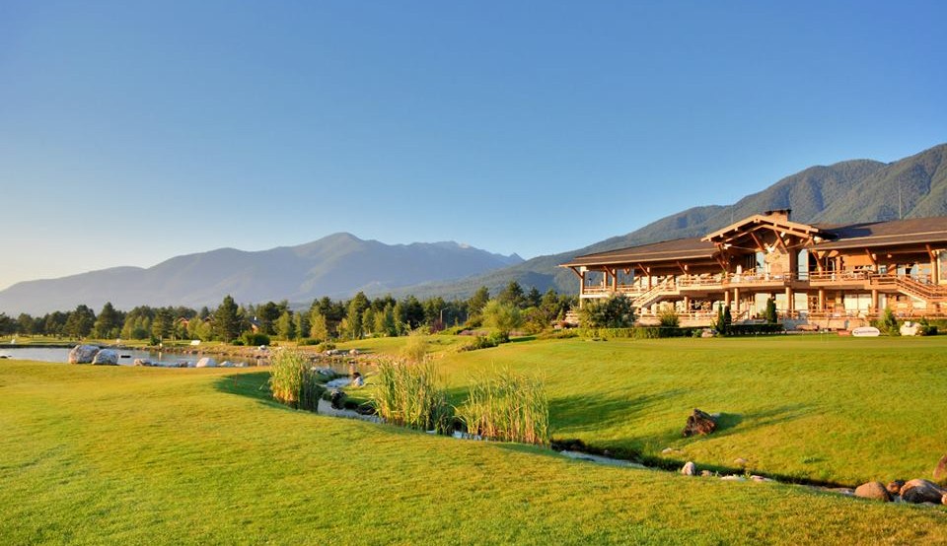
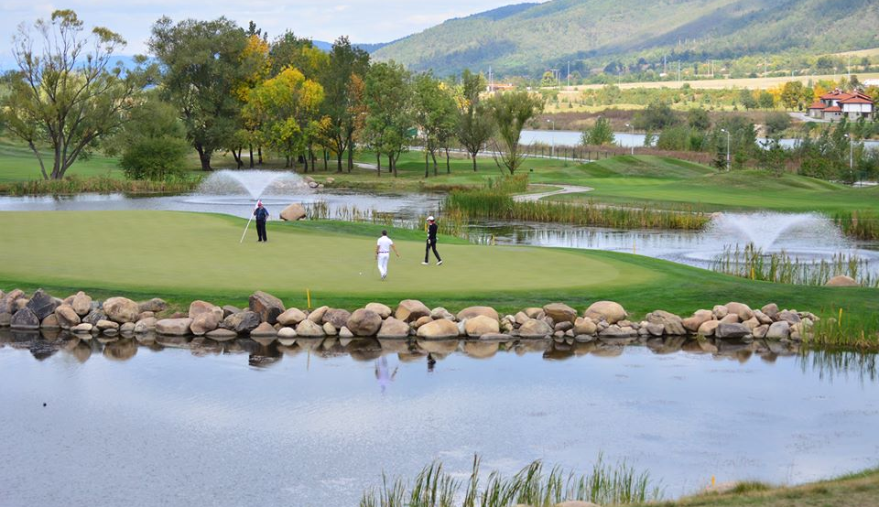
Bulgaria is attractive for golfers and we shall help you to enjoy it in seaside and mountain golf resorts.

Slide 8
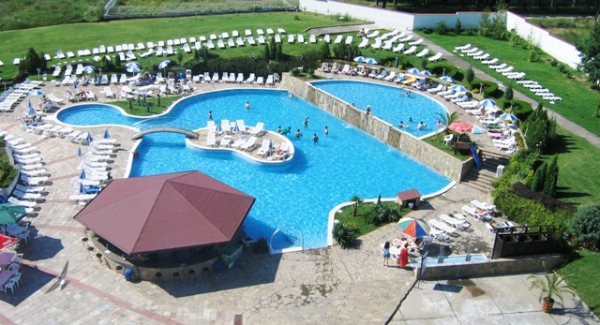
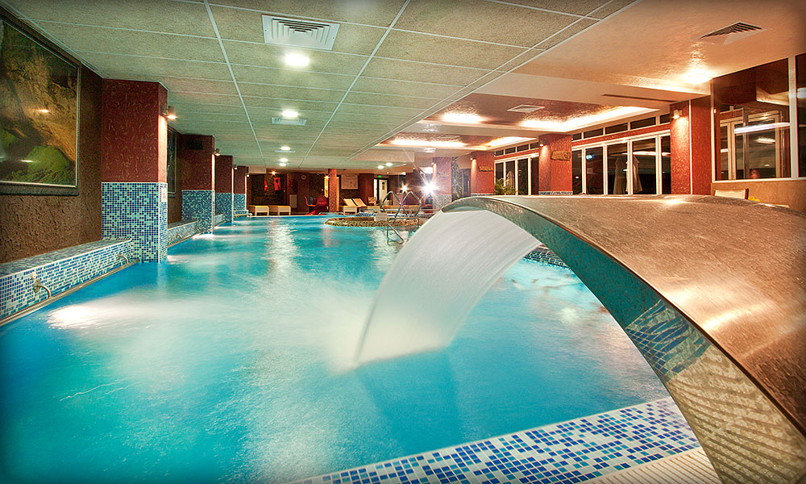
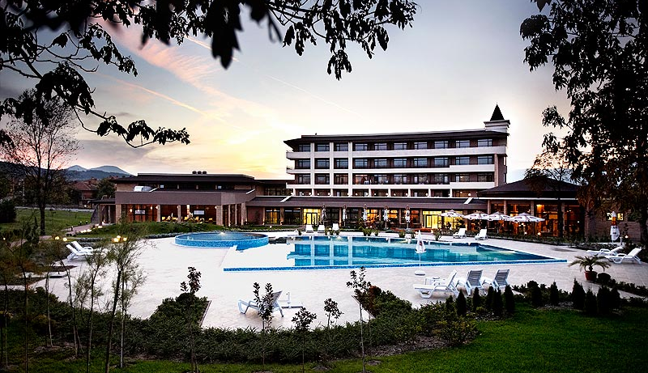
There are more than 550 known sources with 1,600 mineral springs and we shall help you to find their healing power. Just visit Hissarya, Pavel Banya, Velingrad or Sandanski!

Slide 9
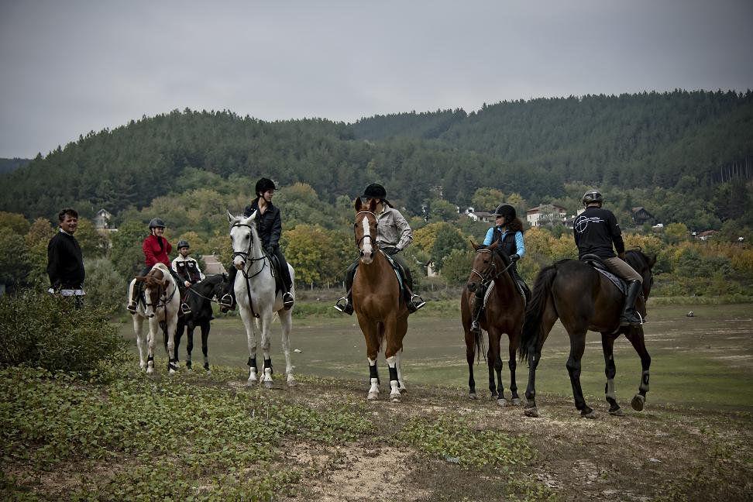
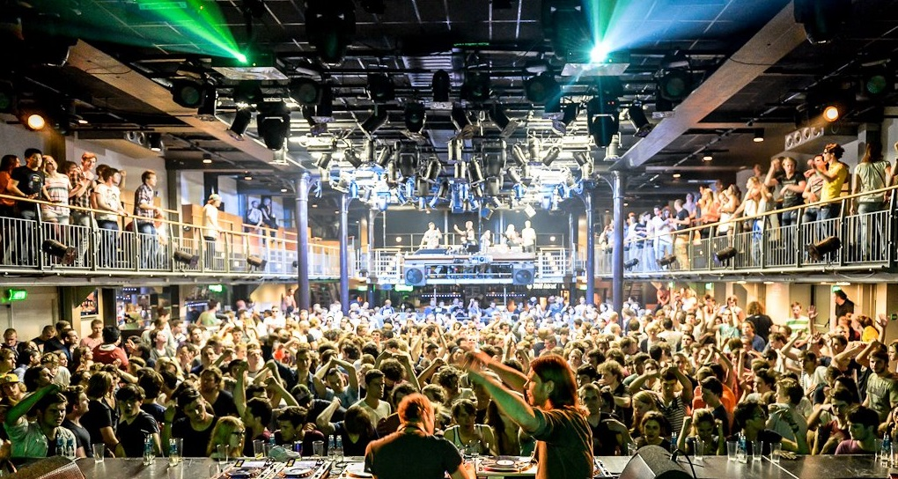
Rozzi Travel is experienced in organizing incentive programs in Bulgaria.

Slide 10
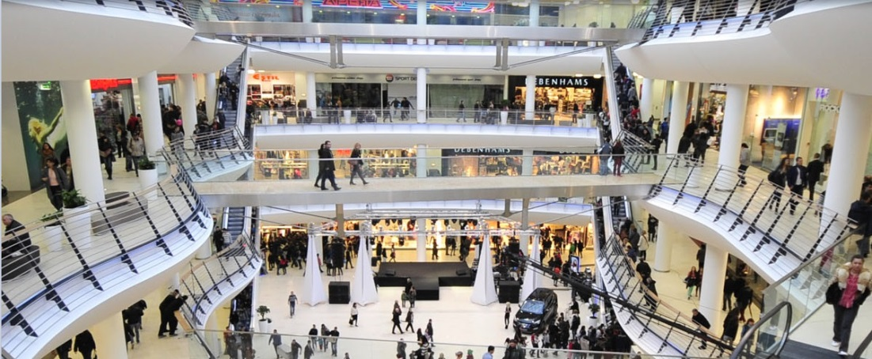
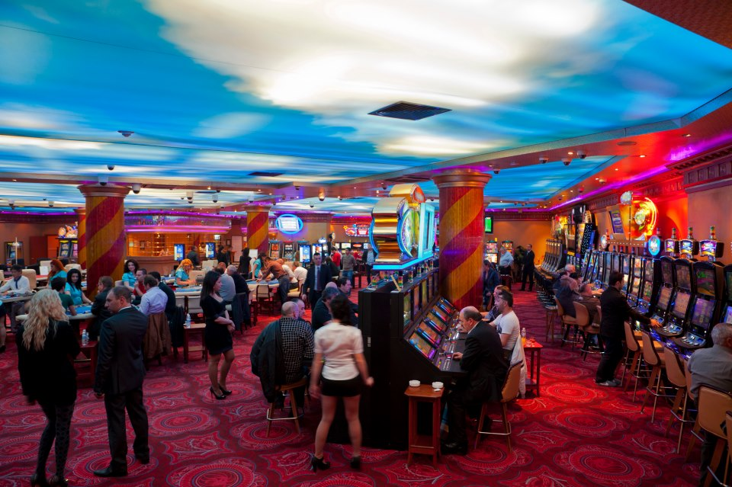
Rozzi Travel will offer you exciting Shopping & Entertainment

Slide 11
We are waiting for you in Bulgaria!
Thank you for your attention!
Contact us: info@rozzitravel.com
+359 (0)2 9446316
+359 (0)2 4372082
+359 (0)2 4372083

